Slide 1
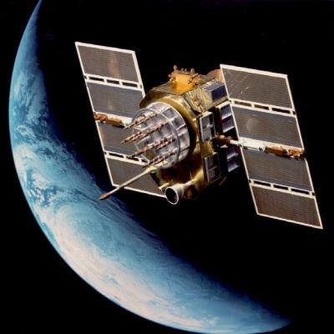
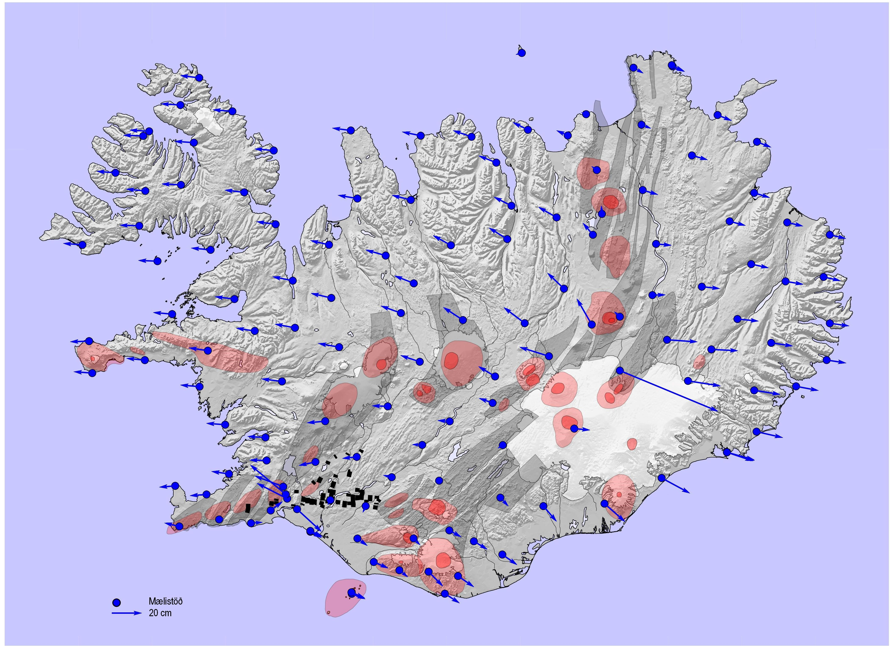
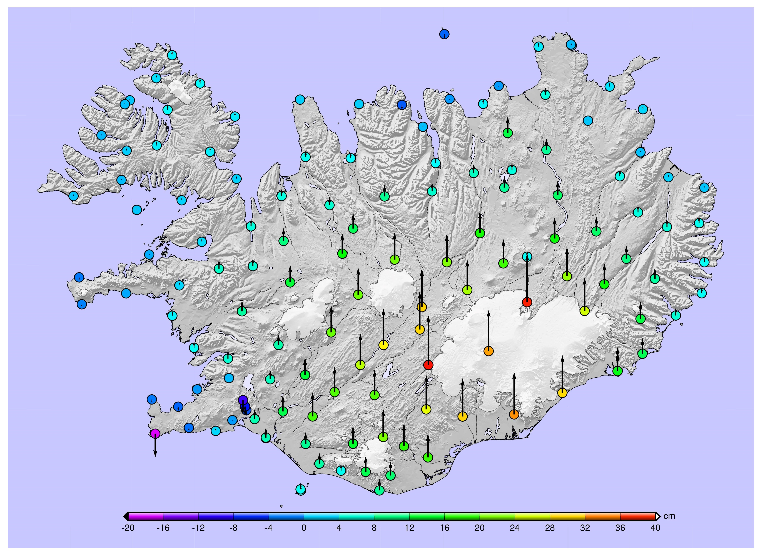
The DRF-Iceland project
NKG 2018 General Assembly
Helsinki, 4 / 9 - 2018
Halfdan Pascal Kierulf, Gudmundur Valsson, Dalia Prizginiene, Kristian Evers, Pasi Häkli, Martin Håkansson, Martin Lidberg, Geir Arne Hjelle, Olav Vestøl, Þórarinn Sigurðsson, Per Knudsen, Markku Poutanen, Abbas Khan
Notes:
Hei!
Tittelen på mitt foredrag er Hvorfor trenger vi så høy nøyaktighet?
Bakgrunnen for foredraget er egentlig neste foredrag av Martin Øen
fra Veidekke og vil snakke om byggingen va det nye observatoriet I Ny-Ålesund.
Jeg antar at han vil snakke om de meget strenge kravene til nøyaktighet og stabilitet som var knyttet til dette annlegsarbeidet.
Jeg vil prøve å sette disse kravene inn I en sammenheng, både
Forskningsmessig, vitenskaplig og internasjonale sammenheng.
Jeg vil også prøve å gi et bilde på hva slags størelser er det vi snakker
Om, hvor stor er en millimeter. Er det noen som kan se millimeteren på bildet over??

Slide 2
Background
Scenario: Smartphones give positions within dm or cm accuracy
  in real time
  in a global and dynamic reference frame
Autonomous driving sets new demands on the reference frame
Australia has decided to implement a fully dynamic reference frame in 2020
Is a static “plate fixed” reference frame the best solution for the users in the future?
The NKG-presidium initiated a pilot project on Dynamical Reference Frame: DRF-Iceland
Notes:
The background for this project is two folded. The technological development change our life. On scenario is that the smartphone may give us precise coordinates – in a global reference frame and in real time. And at the same time we hear out in the big world that Australia has decided to implement a dynamic reference frame.
This is a controversial topic because it is a new way of thinking, and the Nordic Commission of Geodesy established a project to investigate the different aspect further.

Slide 3
The Earth and the Nordic countries are subject to crustal deformations that influence the reference frames
Scandinavia has moved since ETRF89 was realized
  ~50 cm to North-East
  0-20 cm Up
ITRF and ETRF89 differ
Should the reference frame follow the “stable”- plate or the global system?
Notes:
In Scandinavia we have mainly secular motions. Vertically the post glacial rebound is dominating with a maximum of 10 mm annually land uplift at the western shore of the Gulf of Bothnia. Horizontally we are drifting northeast with a speed around 25 mm/year. The post glacial rebound has also a horizontal component – Scandinavia is expanding.

Slide 4
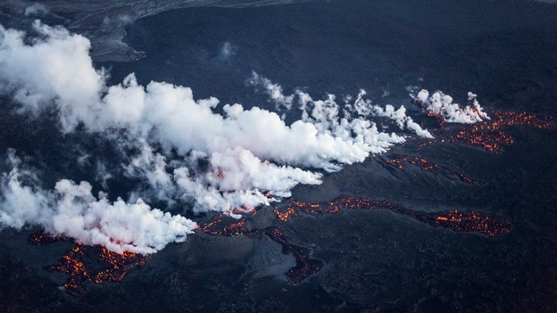
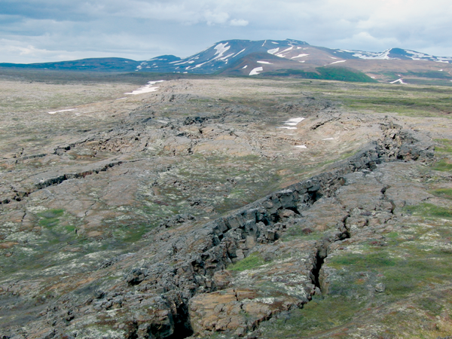
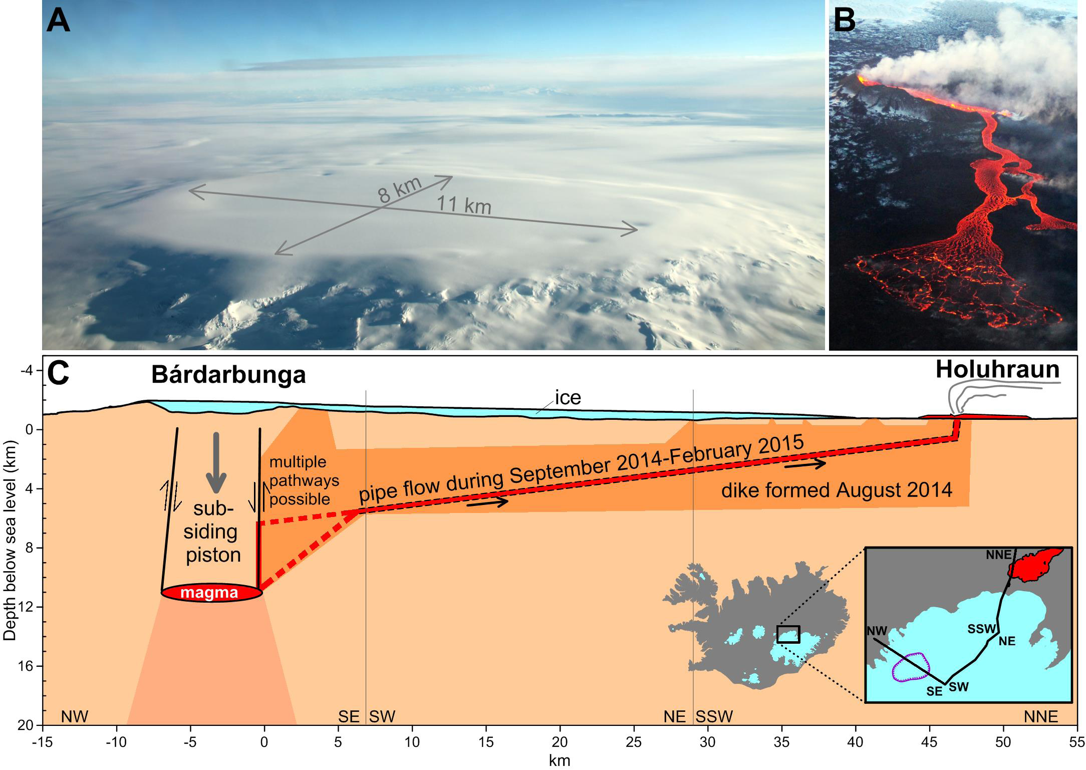
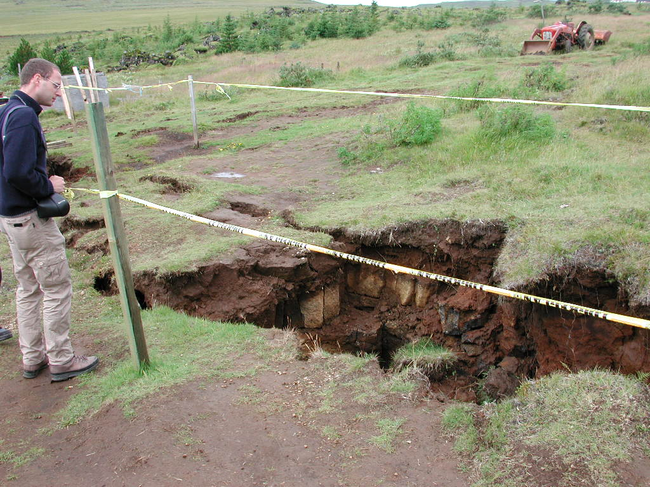
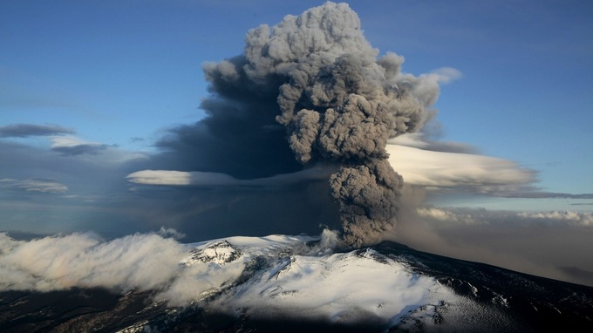
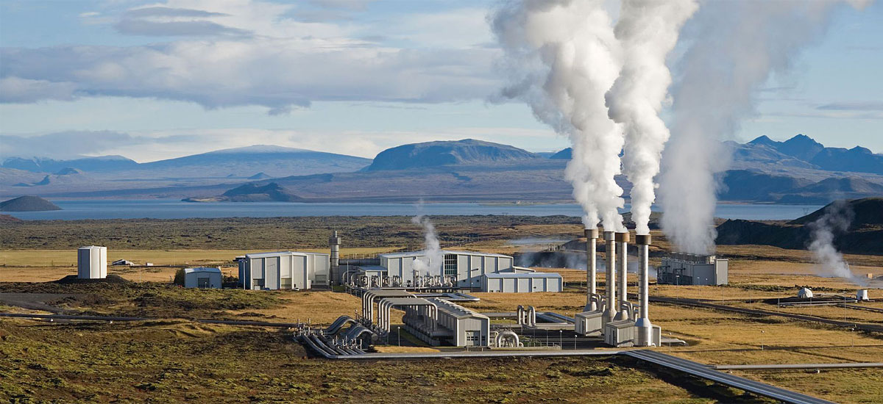
In Iceland the deformations are much more complex
-Two plates are drifting apart ~2-3 cm/year
-Deformations within the plates
-Earthquakes ~50 cm
-Volcanoes
-Melting graciers ~40 mm land uplift annually
~more than 10 mm/yr horizontally
-Geothermal power plants - subsidence
If we could handle the situation in Iceland, we could handle the situation in Scandinavia.
Notes:
In Iceland we have all kinds of secular and non-secular motions. It is difficult monitoring all these motions and also difficult to make models describing these deformations that vary in both space and time.

Slide 5
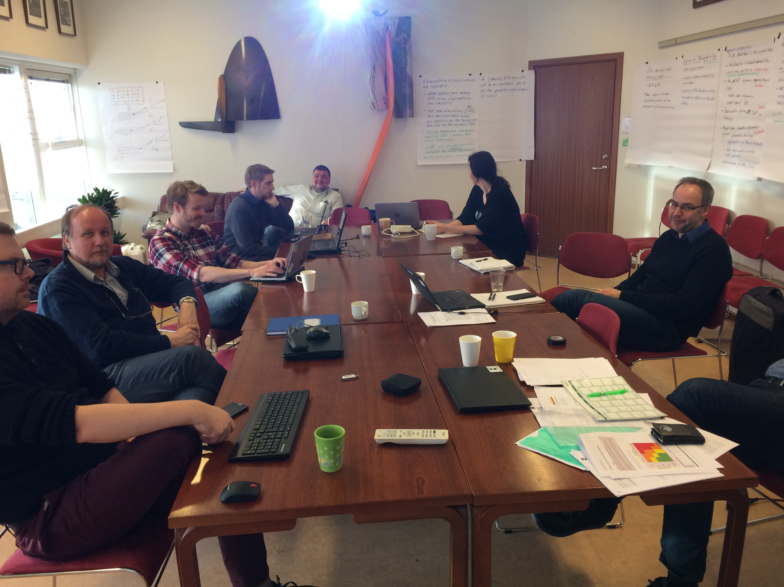
The following competent group was put together to solve the problems
Halfdan Pascal Kierulf, Prosject leader
Gudmundur Valsson, Iceland
Ásta Krístín Óladóttir, Iceland
Hafliði Magnússon, Iceland
Dalia Prizginiene, Iceland
Martin Lidberg, Sweden
Per Knudsen, Denmark
Kristian Evers, Denmark
Markku Poutanen, Finland
Teemu Saloriutta, Finland
Pasi Häkli, Finland
Olav Vestøl, Norway
Geir Arne Hjelle, Norway
Martin Haakanson, Sweden
Per Erik Opseth, Norway, Project owner
NKG Presidium, Steering committee
From the first meeting in Akranes Feb. 22-23, 2017

Slide 6
It is important to have a common understanding
of definitions and vocabulary
-Static RF (Plate fixed, Epoch fixed):
The RF moves with the tectonic plate.
The coordinates (of physical objects) do not change with time.
-Dynamic RF (Earth fixed, kinematic):
The RF does not move with the tectonic plates.
The coordinates (of physical objects) change with time.
-Semi-dynamic RF:
Any possible combination of static and dynamic thinking.
E.g. A “time-series” of static reference frames
A static reference frame with a deformation model (e.g. ETRF89)
ISO19111
From: Text for ISO/DIS 19111, Geographic information
— Referencing by coordinates, as sent to ISO/CS for ballot (2018-01-29)
reference frame/datum
parameter or set of parameters that realize the position of the origin, the scale, and the orientation of a coordinate system
dynamic reference frame/dynamic datum
reference frame in which the defining parameters include time evolution
Note: Semi-dynamic is not mentioned in the document
Notes:
An important part of the project has been trying to clarify the vocabulary.

Slide 7
The project uses a more precise definitions of a Dynamic Reference Frame
A point in a DRF is given by 4-parametres (x,y,z,t), where (x,y,z) is the spatial location in a global reference frame (e.g. ITRF) at epoch t.
A point (x,y,z,t) is:
-uniquely defined
and
- is given directly in the global reference frame
- have the accuracy of the measurements technique
- do not change over time
(but the coordinate of a physical object is different at different epochs)
In addition, we need:
a deformation model to compile or compare coordinates with different epoch
NOTE:
Because of the time tagging you can:
store coordinates in your database even though your deformation model is not updated (e.g. after a large earthquake)
always use the latest and most precise deformation model

Slide 8
Positions in a DRF can be accessed with all techniques
Examples:
-PPP: direct determination in the DRF
-DD: determination through the ITRF coordinates of your reference stations
-RTK: direct determination if the RTK-GNSS stations are continuously updated in ITRF
-Positioning relative a local marker also works, but the time stamp will be the same as for the local markers.
i.e. all techniques determine positions in the same reference frame without transformations.
Notes:
PPP and double difference techniques work very well in a DRF. Also RTK works well, and give you coordinates in current epoch if your stations are updated. Positioning relative to local markers gives a time tagging in accordance with the local markers time stamp.

Slide 9
The project identified ten pre-conditions for
a successful DRF:
1) A sufficiently dense active geodetic infrastructure (CORS) with known coordinates (and uncertainties) in a global reference frame (ITRF).
2) A way to distribute the reference frame to the users, e.g. positioning services.
3) Transformations to other reference frames.
4) Deformation models with sufficient accuracy to meet the future demands for comparison and compiling coordinates from different epochs.
5) Geodetic data archive able to store and handle dynamic coordinates.
6) GIS systems that are able to handle dynamic coordinates in general and in particular the time dimension of a dynamic reference frame and the various transformations needed.
7) Legal foundation of dynamic reference frames (e.g. for cadastre).
8) Training and education of surveyors.
9) Training and education of GIS users.
10) Willingness of the users to take such a system into use.

Slide 10
Deliverables of the DRF-Iceland projects included:
11 documents, three sets of results and two test services
 | Document | Results | Test service
DRF-Iceland pre-project
 | How to define a dynamic reference frame
 | Geodesy in Iceland
 | Spatial data infrastructure in Iceland
 | GIS and dynamic reference frames
 | DRF Iceland project proposal
DRF-Iceland-S1
WP1: Realization of DRF-Iceland | D1.1: Specification of the GNSS analysis strategy and reference frame realization for the DRF-Iceland
 | D1.2: Set up an operational GNSS analysis of Icelandic CORS
 | D1.3: Determine a preliminary secular velocity field for the Icelandic GNSS stations
 | D1.4: Time-series analysis for determination of velocities and deformations of Icelandic GNSS stations
WP2: Access to DRF (user perspective) | D2.1: Review of the RTK software options with respect to the requirements of dynamic coordinates in a DRF
 | D2.2: Implementing a test-RTK service delivering DRF coordinates
 | D2.3: Review of the quality of global PPP for positioning
WP3: Deformation model | D3.1: Description of concept for deformation model D3.2: Description of concepts for handling secular motions and deformation events
 | D3.3: Determination of a preliminary deformation model
 | D3.4: Description of how to implement deformation model in GIS systems
WP4: Plan for a long term NKG-activity | D4: Document describing the plan for the NKG-activity 2018-2022
Gudmundur
9.40-10.00
Geir-Arne +
10.00-10.20
Kristian E.
Wed 15.30

Slide 11
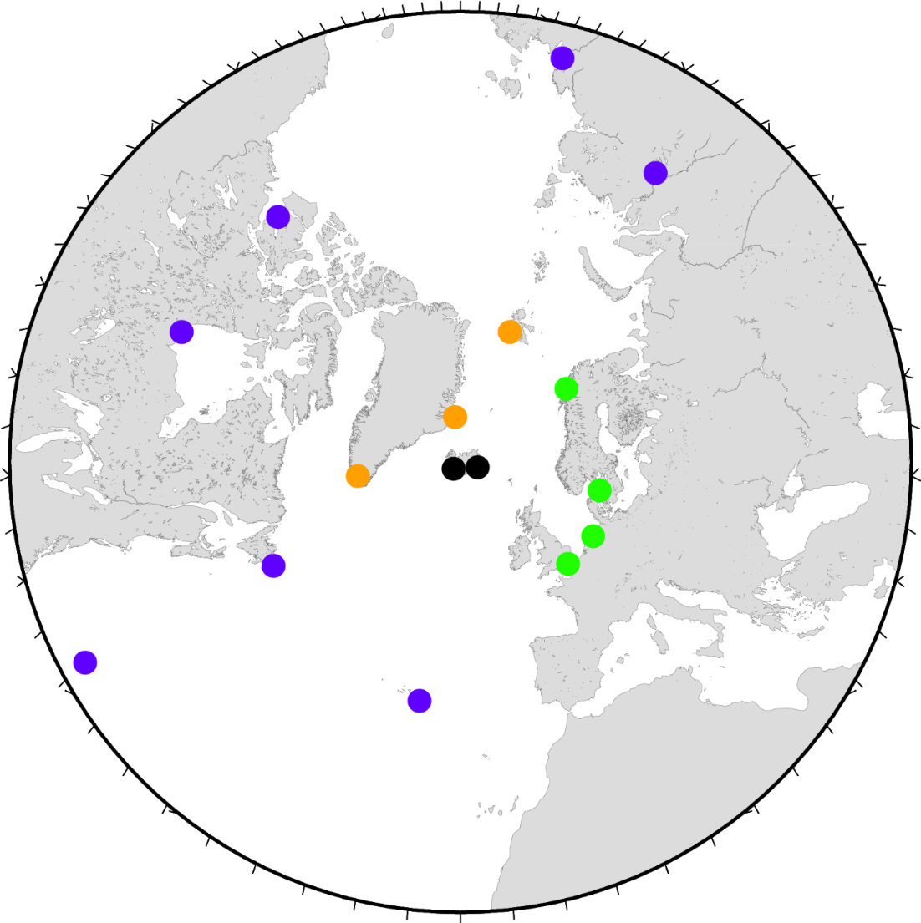
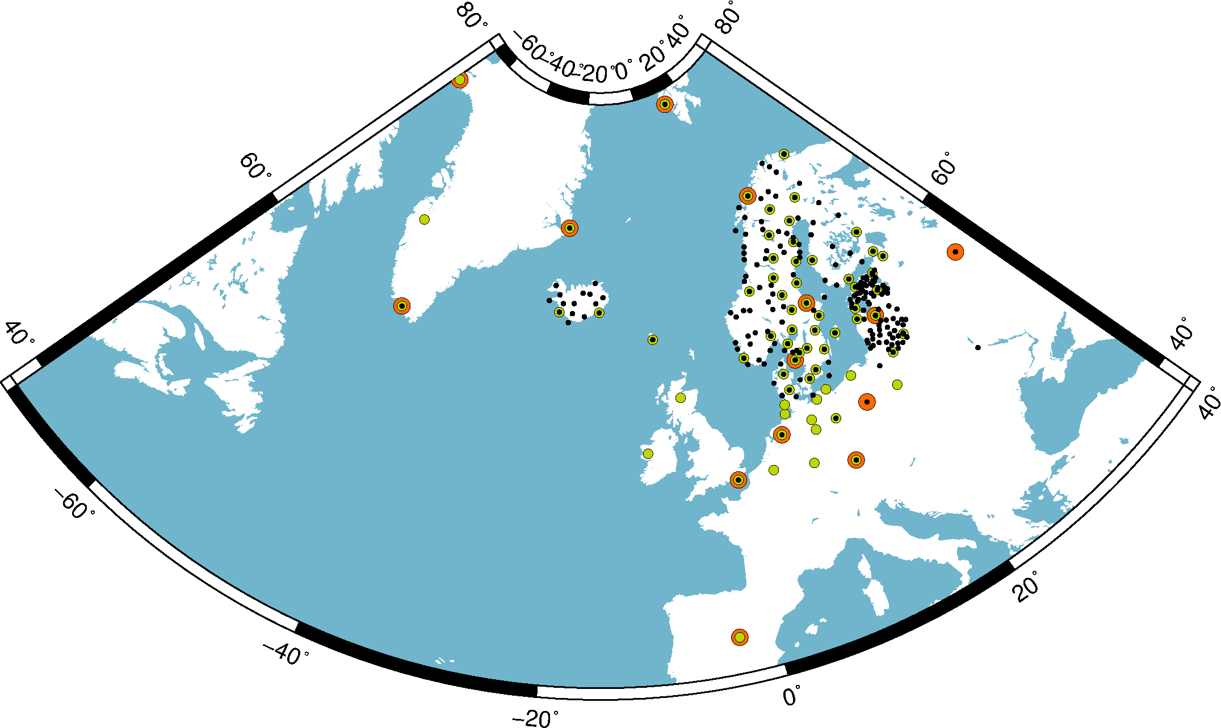
The reference frame realization will be based on the NKG-GNSS analysis center
  Include stable stations surrounding Iceland
  Might be necessary with lower latency

Slide 12
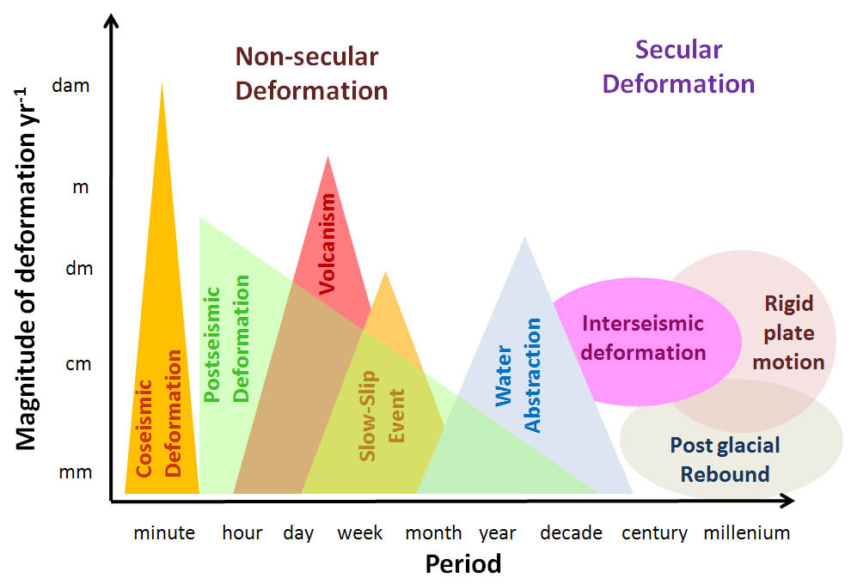
Deformation processes have different spatial and temporal scales and must be handled accordingly
Hydrological
Loadings
By courtesy of Craig Roberts, Richard Stanaway et at.
Deformation model Velocity field
Patches or ...
Notes:
In Scandinavia we can talk about a velocity field. In Iceland the deformation models will change with time and the deformation will in a way be four dimensional.

Slide 13
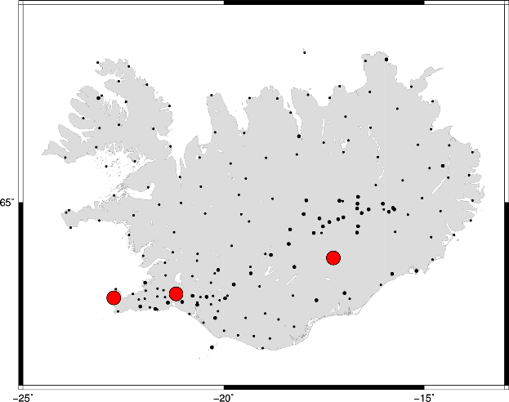
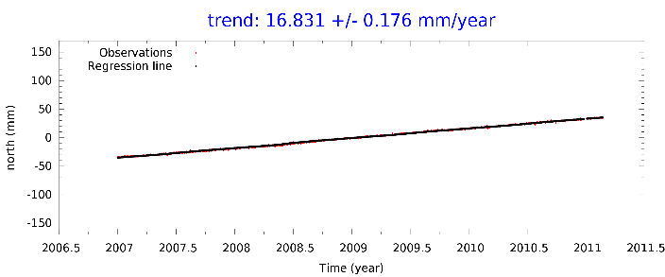
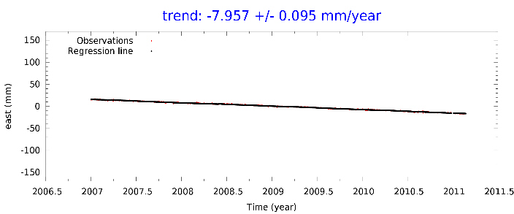
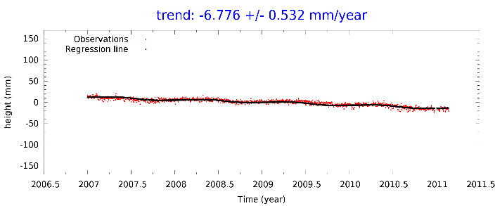
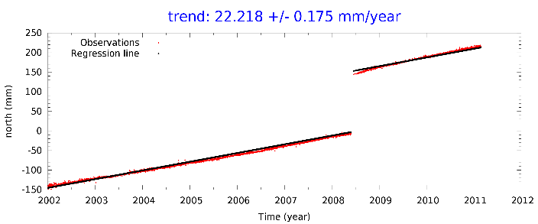
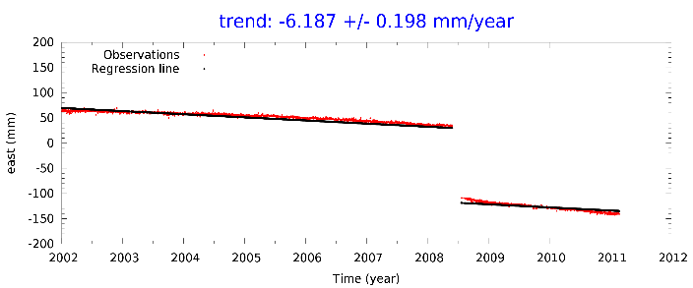
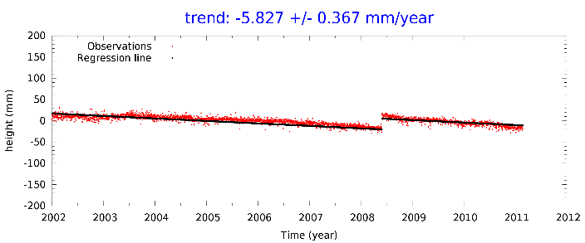
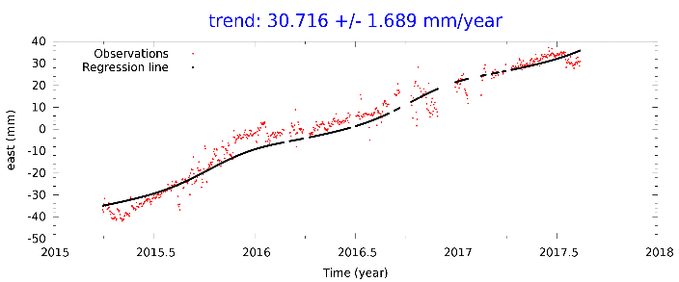
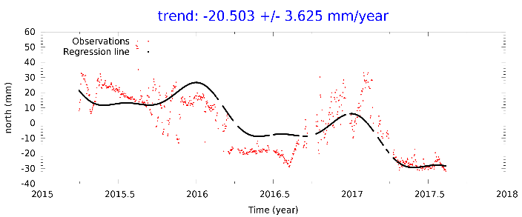
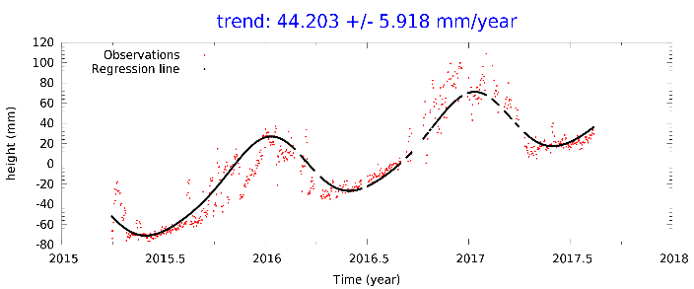
GNSS time-series are our main tool to
estimate velocities and deformations
GFUM
NYLA
NYLA: Plate tectonics, GIA .. (linear)
HVER
HVER: Earth quakes (breaks and post-seismic deformations)
GFUM: Volcanoes and melting glaciers

Slide 14
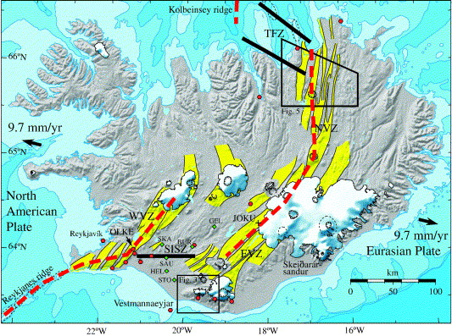
GNSS velocities are input for
the velocity field
In Fennoscandia colocation works well
In Iceland the situation is more complex
Colocation with geophysical constraints
Notes:
Hei!
Tittelen på mitt foredrag er Hvorfor trenger vi så høy nøyaktighet?
Bakgrunnen for foredraget er egentlig neste foredrag av Martin Øen
fra Veidekke og vil snakke om byggingen va det nye observatoriet I Ny-Ålesund.
Jeg antar at han vil snakke om de meget strenge kravene til nøyaktighet og stabilitet som var knyttet til dette annlegsarbeidet.
Jeg vil prøve å sette disse kravene inn I en sammenheng, både
Forskningsmessig, vitenskaplig og internasjonale sammenheng.
Jeg vil også prøve å gi et bilde på hva slags størelser er det vi snakker
Om, hvor stor er en millimeter. Er det noen som kan se millimeteren på bildet over??

Slide 15
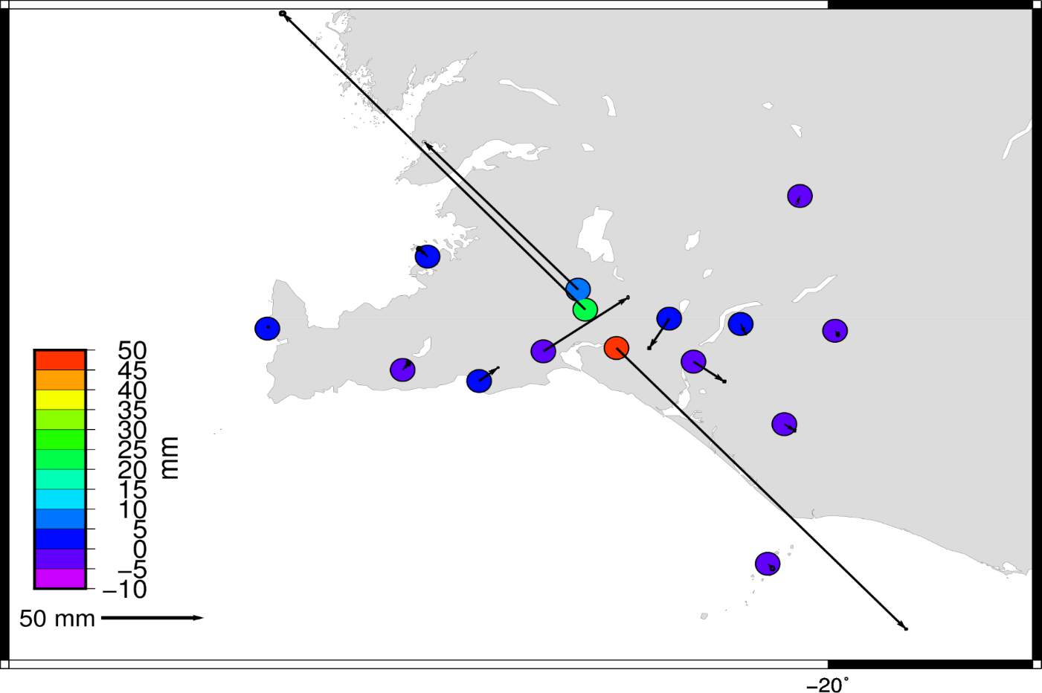
The earthquake in Reykjavik (Mw 6.3) in 2008 caused large crustal deformations
HVER
We need more advanced modelling

Slide 16
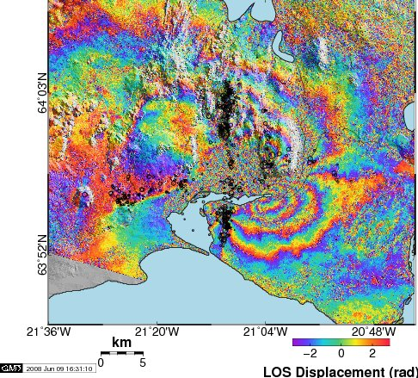

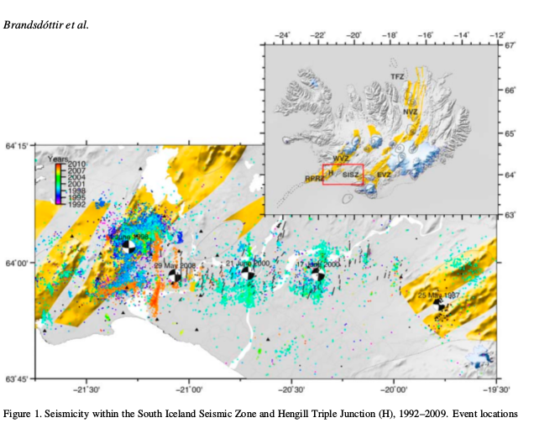
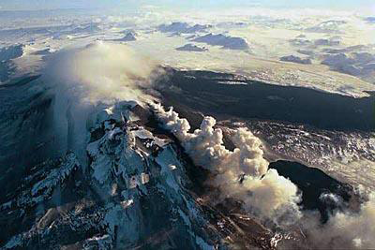
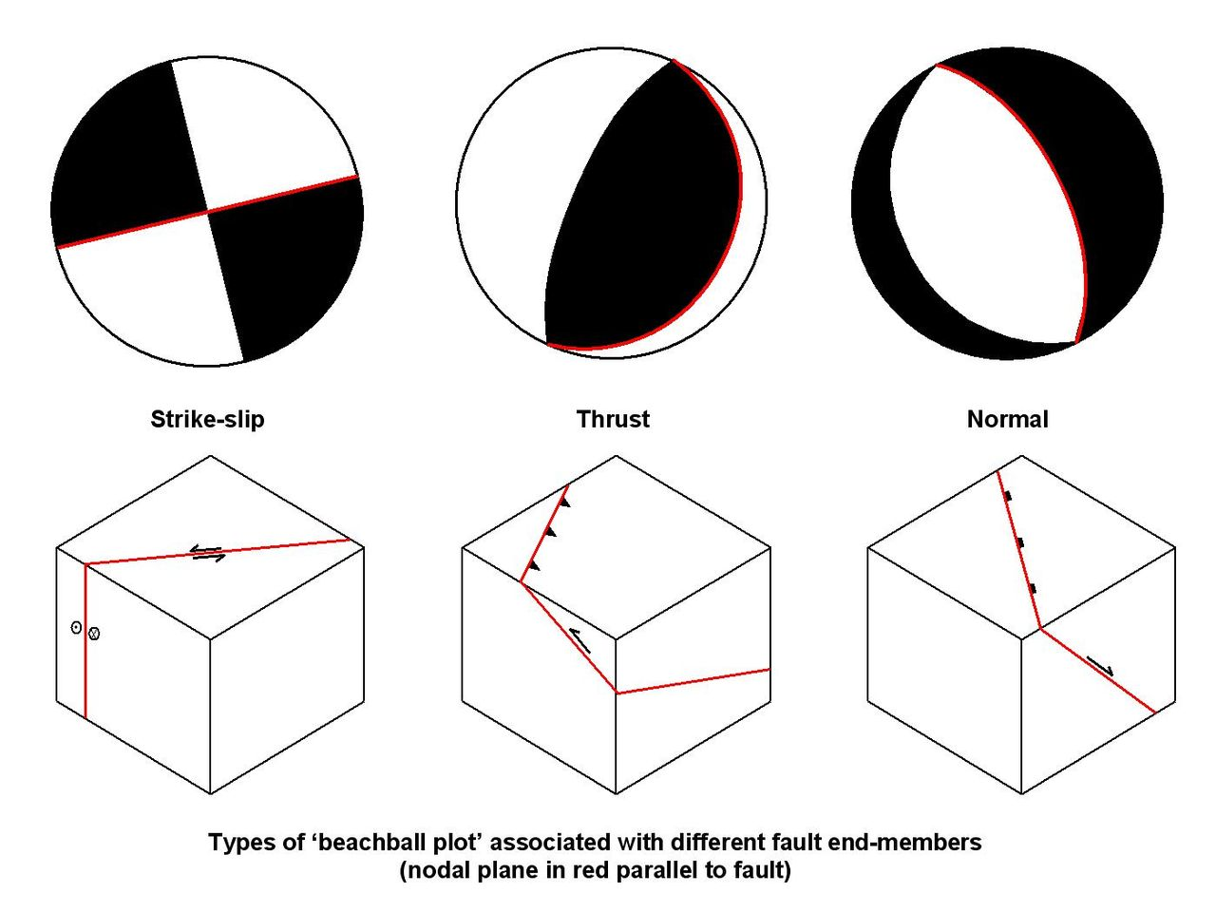
Various models and measurements are necessary to make a good deformation model
InSAR
GNSS
The ultimate goal:
A spatial and temporal continuous deformation model. Automatically updated in real time
Geophysical models

Slide 17
Some conclusions from the project group:
Deformation model and velocity field is mandatory regardless of type of reference frame
User groups will request a reference frame homogeneous over boarders and consistent with global positioning systems
For legal issues e.g. cadastre and inspire directive, a static reference frame is mandatory in foreseeable future.
A two frame approach might be an alterative (like Australia)

Slide 18
Future work:
The work with DRF should continue within NKG
Develop a common Nordic DRF, that imply:
  A common Nordic realization at CORS
  A Nordic velocity field
  Necessary GIS tools
The level of implementation might vary between countries
How can we approach the users of the reference frame?

Slide 19
ISO19111
From: Text for ISO/DIS 19111, Geographic information — Referencing by coordinates, as sent to ISO/CS for ballot (2018-01-29)
reference frame/datum
parameter or set of parameters that realize the position of the origin, the scale, and the orientation of a coordinate system
dynamic reference frame/dynamic datum
reference frame in which the defining parameters include time evolution
coordinate reference system
coordinate system that is related to an object by a datum
static coordinate reference system
coordinate reference system that has a static reference frame without an associated deformation model or a dynamic reference frame with coordinates referenced to a single fixed epoch
dynamic coordinate reference system
coordinate reference system that has a dynamic reference frame with or without an associated deformation model or that has a static reference frame with an associated deformation model
Semi-dynamic is not mentioned in the document!

Slide 20
6.2 ATRF
The Australian Terrestrial Reference Frame (ATRF) is basically a regional realisation of the
ITRF, based on almost 200 globally distributed International GNSS Service (IGS) stations
and the Asia-Pacific Reference Frame (APREF) network consisting of about 500 stations
(GA, 2017a). As a consequence, Australian spatial information will be directly interoperable
with GNSS measurements, i.e. mass market applications will not see a discrepancy
between global coordinates and ATRF.
It is anticipated that the ATRF will be implemented from January 2020 with adoption planned
to be complete by 2023. However, it is important to note that GDA2020 and ATRF will exist
in tandem for the foreseeable future. Practically, GDA2020 and ATRF can really be thought
of as one product – the former being fixed to epoch 2020.0, while the latter refers to the
current epoch (or any other user-specified epoch).
From: GDA2020, AUSGeoid2020 and ATRF: An Introduction. 2017, Volker Janssen

Slide 21
GIS challenges
Key question: How should the time dimension be handled in GIS!
What we already have:
  Satisfactory standards for describing metadata of geospatial exists
  File formats that can accommodate the required spatiotemporal coordinates
  A coordinate transformation platform with widespread usage that can be extended into the realm of dynamic reference frames: PROJ.4
What we are missing:
  Widespread adaptation of the most recent metadata standards (WKT2)
  Usage of the new PROJ.4 API in geospatial software
  Extended geodetic capabilities in PROJ.4
  14 param. shifts, temporal awareness, etc
  A different user mindset
Updating map databases:
  How will web services (WMS, WFS, etc) work in a dynamic reference frame? Often huge amounts of data which is not feasible to transform on the fly. Should it be transformed and updated to “current epoch” with regular intervals? How often? Every week, month or year?
Notes:
We have also tried to go into some GIS aspects. There are standards and file formats available that can be used. But so far there is no widespread adaption of any of them. When it coms to transformation, the widespread transformation platform is not satisfactory. However, I think what is most challenging is the change in mindset; that the coordinates change with time. Dynamic reference frames put a heavy burden on the map database operators. What used to be a job for the surveyors, is now theirs.

Slide 22
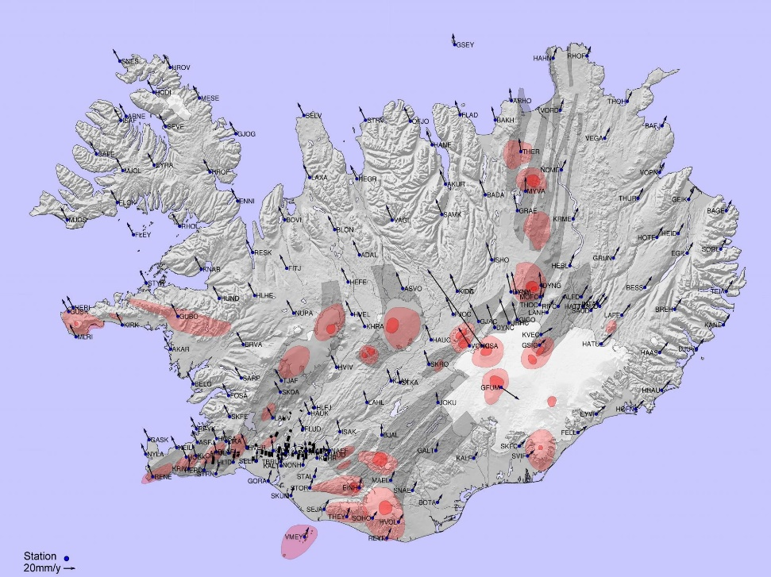
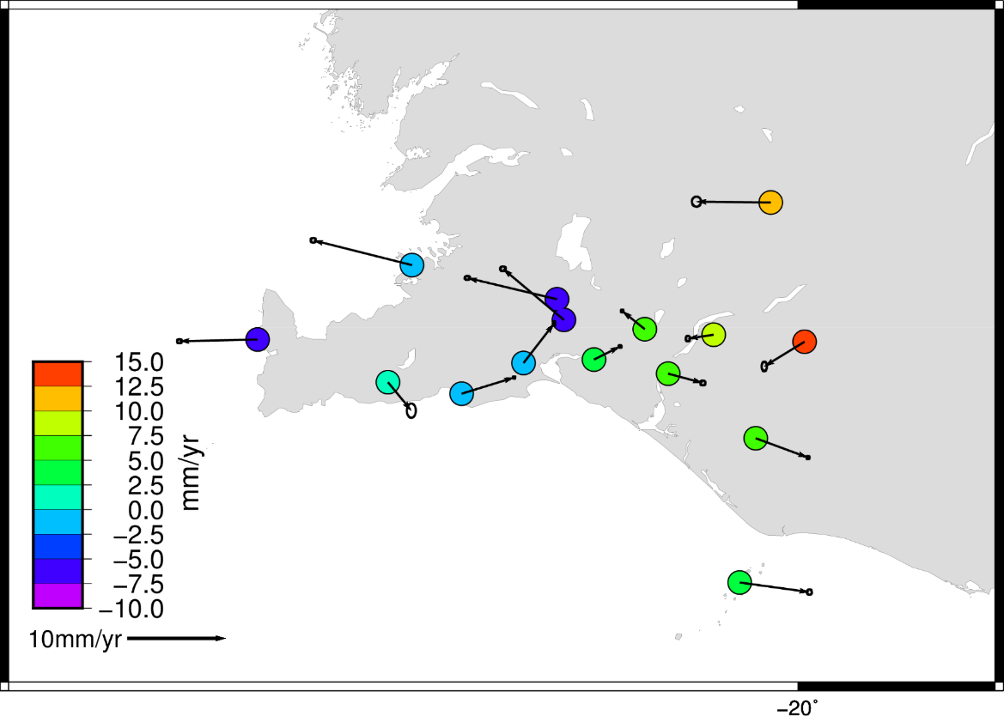
GNSS velocities are input for
the velocity field
In Fennoscandia colocation works well
In Iceland the situation is more complex
Colocation with geophysical constraints
Notes:
Hei!
Tittelen på mitt foredrag er Hvorfor trenger vi så høy nøyaktighet?
Bakgrunnen for foredraget er egentlig neste foredrag av Martin Øen
fra Veidekke og vil snakke om byggingen va det nye observatoriet I Ny-Ålesund.
Jeg antar at han vil snakke om de meget strenge kravene til nøyaktighet og stabilitet som var knyttet til dette annlegsarbeidet.
Jeg vil prøve å sette disse kravene inn I en sammenheng, både
Forskningsmessig, vitenskaplig og internasjonale sammenheng.
Jeg vil også prøve å gi et bilde på hva slags størelser er det vi snakker
Om, hvor stor er en millimeter. Er det noen som kan se millimeteren på bildet over??

